Slide 1
An In-Memory, Append-Only, Single-Table Database

Slide 2
support two operations: inserting a row and printing all rows
reside only in memory (no persistence to disk)
support a single, hard-coded table

Slide 3
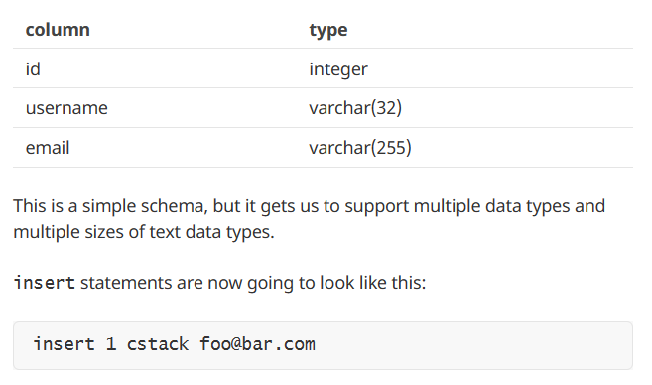

Slide 4
Store rows in blocks of memory called pages
Each page stores as many rows as it can fit
Rows are serialized into a compact representation with each page
Pages are only allocated as needed
Keep a fixed-size array of pointers to pages

